Slide 1
Software Testing

Slide 2
Software Testing
Testing is the process of evaluating a system or its component(s) with the intent to find whether it satisfies the specified requirements or not.
Testing is executing a system in order to identify any gaps, errors, or missing requirements in contrary to the actual requirements.

Slide 3
Who does Testing?
It depends on the process and the associated stakeholders of the project(s). In the IT industry, large companies have a team with responsibilities to evaluate the developed software in context of the given requirements
Different companies have different designations for people who test the software on the basis of their experience and knowledge such as Software Tester, Software Quality Assurance Engineer, QA Analyst, etc.

Slide 4
When to Start Testing?
An early start to testing reduces the cost and time to rework and produce error-free software that is delivered to the client
However in Software Development Life Cycle (SDLC), testing can be started from the Requirements Gathering phase and continued till the deployment of the software.
In the Waterfall model, formal testing is conducted in the testing phase; but in the incremental model, testing is performed at the end of every increment/iteration and the whole application is tested at the end.

Slide 5
Testing is done in different forms at every phase of SDLC
During the requirement gathering phase, the analysis and verification of requirements are also considered as testing.
Reviewing the design in the design phase with the intent to improve the design is also considered as testing.
Testing performed by a developer on completion of the code is also categorized as testing.

Slide 6
When to Stop Testing?
It is difficult to determine when to stop testing, as testing is a never-ending process and no one can claim that a software is 100% tested
The following aspects are to be considered for stopping the testing process:
Testing Deadlines
Completion of test case execution
Completion of functional and code coverage to a certain point
Bug rate falls below a certain level and no high-priority bugs are identified
Management decision

Slide 7
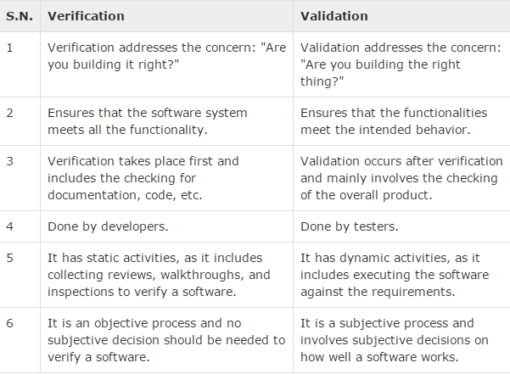
Verification & Validation

Slide 8
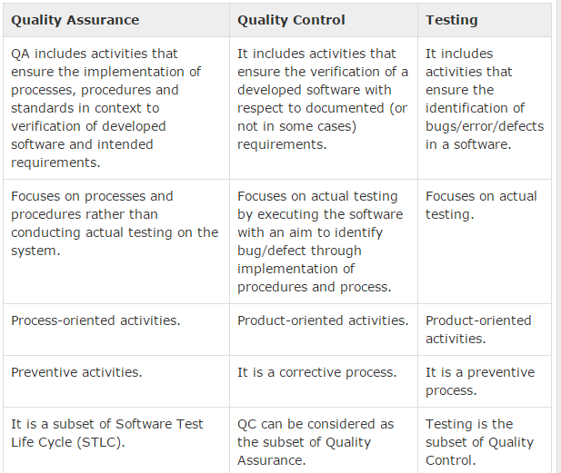
Software Testing - QA, QC & Testing

Slide 9
Software Testing - Types of Testing
Manual Testing
Automation Testing
Manual testing includes testing a software manually, i.e., without using any automated tool or any script.

Slide 10
Automation testing, which is also known as Test Automation, is when the tester writes scripts and uses another software to test the product.
This process involves automation of a manual process. Automation Testing is used to re-run the test scenarios that were performed manually, quickly, and repeatedly.

Slide 11
Apart from regression testing, automation testing is also used to test the application from load, performance, and stress point of view.
It increases the test coverage, improves accuracy, and saves time and money in comparison to manual testing.

Slide 12
What is Automate?
It is not possible to automate everything in a software. The areas at which a user can make transactions such as the login form or registration forms, any area where large number of users can access the software simultaneously should be automated.
Furthermore, all GUI items, connections with databases, field validations, etc. can be efficiently tested by automating the manual process.

Slide 13
When to Automate?
Test Automation should be used by considering the following aspects of a software:
Large and critical projects
Projects that require testing the same areas frequently
Requirements not changing frequently
Accessing the application for load and performance with many virtual users
Stable software with respect to manual testing
Availability of time

Slide 14
How to Automate?
Identifying areas within a software for automation
Selection of appropriate tool for test automation
Writing test scripts
Development of test suits
Execution of scripts
Create result reports
Identify any potential bug or performance issues

Slide 15
Software Testing Tools
HP Quick Test Professional
Selenium
IBM Rational Functional Tester
IBM Rational Performance Tester
SilkTest
TestComplete
Testing Anywhere
WinRunner
LoadRunner
Visual Studio Test Professional
Junit
SoapUI

Slide 16
Testing Techniques
Black-Box Testing
The technique of testing without having any knowledge of the interior workings of the application is called black-box testing.
The tester is oblivious to the system architecture and does not have access to the source code.
Typically, while performing a black-box test, a tester will interact with the system's user interface by providing inputs and examining outputs without knowing how and where the inputs are worked upon.

Slide 17
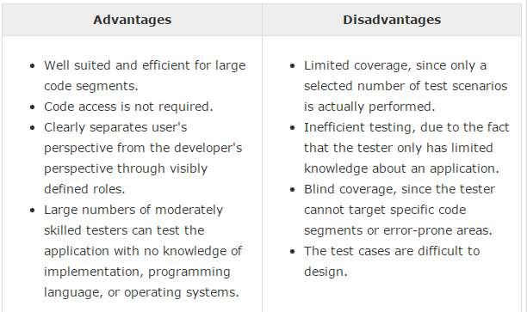

Slide 18
White Box Testing
White-box testing is the detailed investigation of internal logic and structure of the code. White-box testing is also called glass testing or open-box testing.
In order to perform white-box testing on an application, a tester needs to know the internal workings of the code.
The tester needs to have a look inside the source code and find out which unit/chunk of the code is behaving inappropriately.

Slide 19
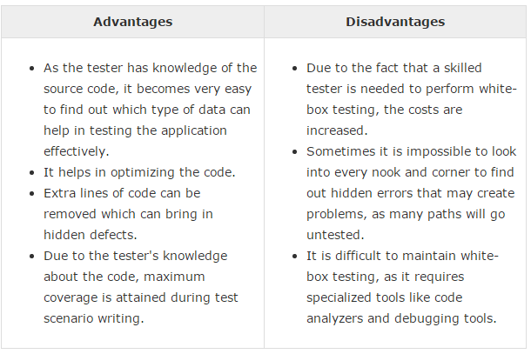

Slide 20
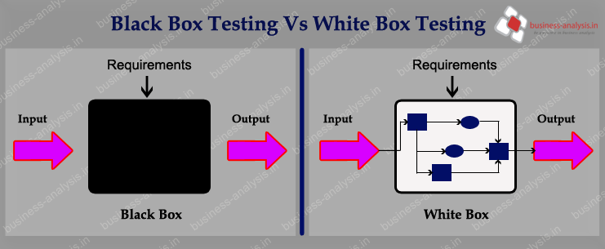

Slide 21
Grey-Box Testing
Grey-box testing is a technique to test the application with having a limited knowledge of the internal workings of an application.

Slide 22
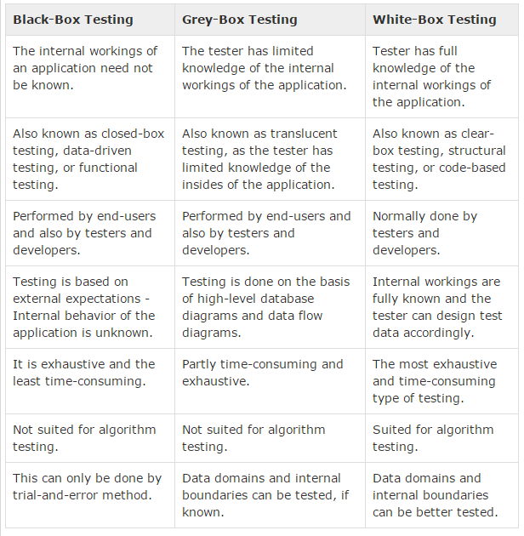

Slide 23
Software Testing - Levels
Functional Testing
This is a type of black-box testing that is based on the specifications of the software that is to be tested.
The application is tested by providing input and then the results are examined that need to conform to the functionality it was intended for.
Functional testing of a software is conducted on a complete, integrated system to evaluate the system's compliance with its specified requirements.

Slide 24
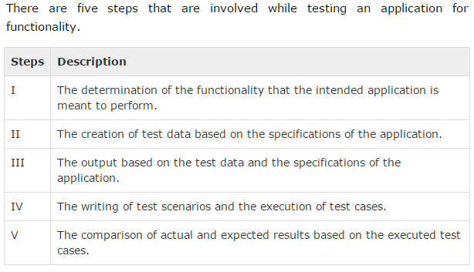

Slide 25
Unit Testing
This type of testing is performed by developers before the setup is handed over to the testing team to formally execute the test cases.
Unit testing is performed by the respective developers on the individual units of source code assigned areas.
The developers use test data that is different from the test data of the quality assurance team.
The goal of unit testing is to isolate each part of the program and show that individual parts are correct in terms of requirements and functionality.

Slide 26
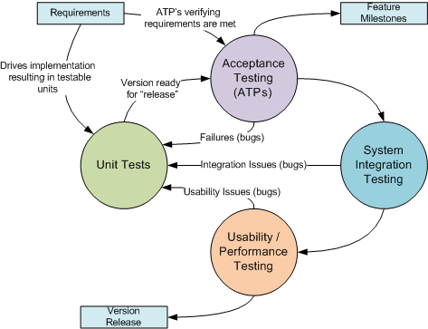

Slide 27
Limitations of Unit Testing
Testing cannot catch each and every bug in an application.
It is impossible to evaluate every execution path in every software application.
The same is the case with unit testing.

Slide 28
Integration Testing
Integration testing is defined as the testing of combined parts of an application to determine if they function correctly.
Integration testing can be done in two ways: Bottom-up integration testing and Top-down integration testing.

Slide 29
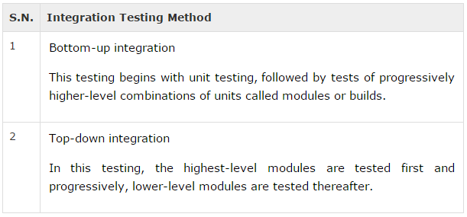

Slide 30
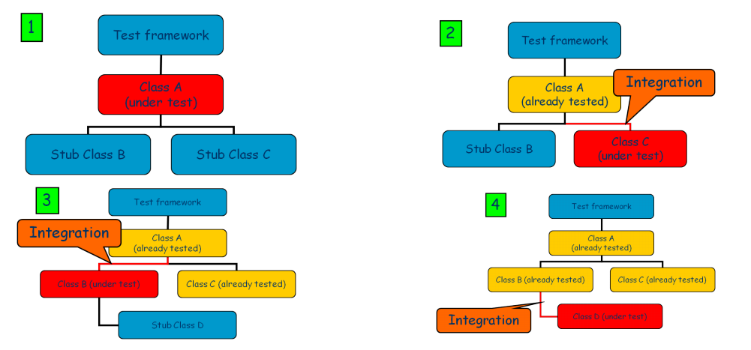
Top Down

Slide 31
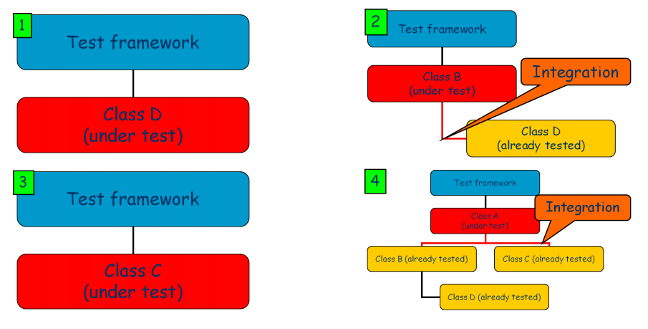
Bottom up

Slide 32
System Testing
System testing tests the system as a whole. Once all the components are integrated, the application as a whole is tested rigorously to see that it meets the specified Quality Standards.
This type of testing is performed by a specialized testing team.

Slide 33
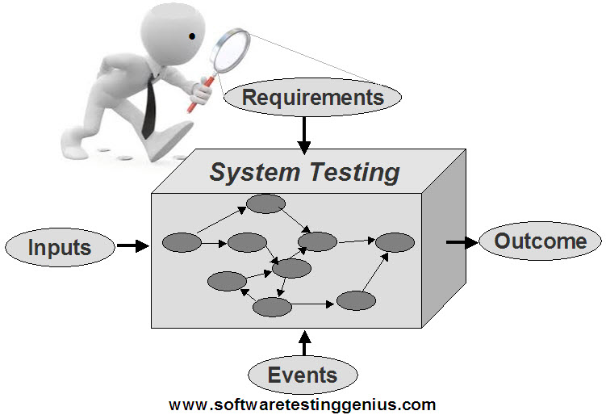
System Testing

Slide 34
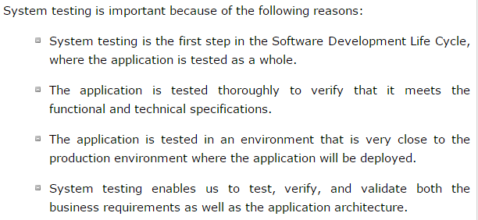

Slide 35
Regression Testing
Whenever a change in a software application is made, it is quite possible that other areas within the application have been affected by this change.
Regression testing is performed to verify that a fixed bug hasn't resulted in another functionality or business rule violation.
The intent of regression testing is to ensure that a change, such as a bug fix should not result in another fault being uncovered in the application.

Slide 36
Acceptance Testing
This is arguably the most important type of testing, as it is conducted by the Quality Assurance Team who will gauge whether the application meets the intended specifications and satisfies the client’s requirement.
The QA team will have a set of pre-written scenarios and test cases that will be used to test the application.
By performing acceptance tests on an application, the testing team will deduce how the application will perform in production.
There are also legal and contractual requirements for acceptance of the system.

Slide 37
Alpha Testing
This test is the first stage of testing and will be performed amongst the teams (developer and QA teams).
Unit testing, integration testing and system testing when combined together is known as alpha testing.
During this phase, the following aspects will be tested in the application:
Spelling Mistakes
Broken Links
Cloudy Directions
The Application will be tested on machines with the lowest specification to test loading times and any latency problems.

Slide 38
Beta Testing
This test is performed after alpha testing has been successfully performed.
In beta testing, a sample of the intended audience tests the application.
Beta testing is also known as pre-release testing.
Beta test versions of software are ideally distributed to a wide audience on the Web, partly to give the program a "real-world" test and partly to provide a preview of the next release.

Slide 39
In this phase, the audience will be testing the following:
Users will install, run the application and send their feedback to the project team.
Typographical errors, confusing application flow, and even crashes.
Getting the feedback, the project team can fix the problems before releasing the software to the actual users.
The more issues you fix that solve real user problems, the higher the quality of your application will be.
Having a higher-quality application when you release it to the general public will increase customer satisfaction.

Slide 40
Non-Functional Testing
This section is based upon testing an application from its non-functional attributes. Non-functional testing involves testing a software from the requirements which are nonfunctional in nature but important such as performance, security, user interface, etc.

Slide 41
Thank You

